Slide 1
11.24 PYSINDY
AYAN DEEP HAZRA

Slide 2
BACKGROUND
Concentrations measured as a percentage of 0.1M. For instance, 90-10 Gly-Ala means 0.09M of Gly and 0.01M of Ala.
Original Model simulates various starting IC’s.
Recovered Model (using SINDY) does the same.
Because recovery is very good, the plots are (for the most part) identical.
Ignore Y0 plots, time vs time.

Slide 3
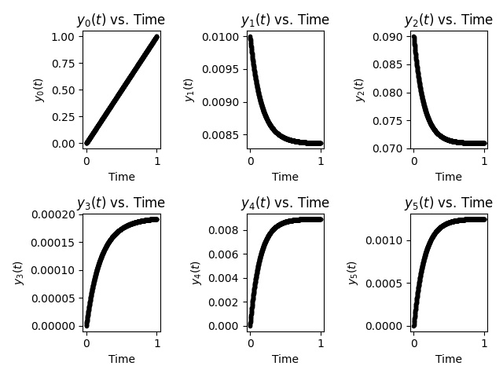
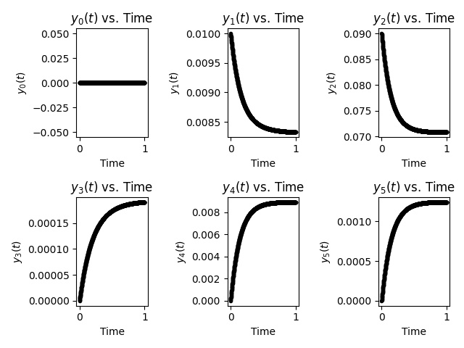
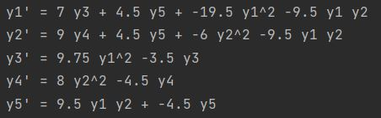
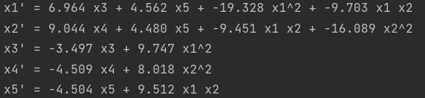
10-90 (g+a->gg+aa+ga/ag) initial conditions for simulation
Y1->G
Y2->A
Y3->GG
Y4->AA
Y5
->GA/AG
ORIGINAL MODEL
PYSINDY RECOVERED MODEL

Slide 4
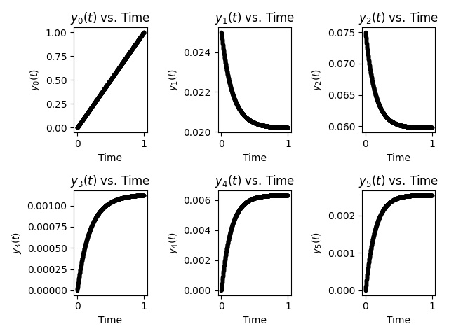
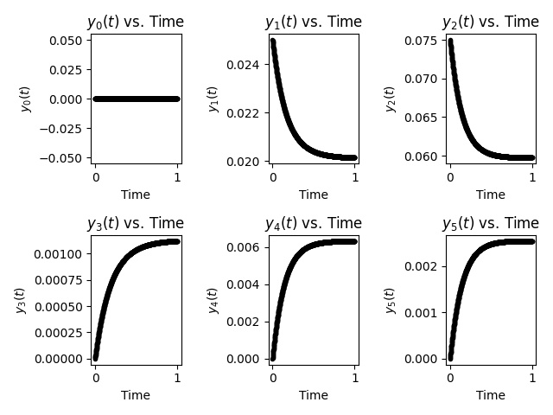
25-75 initial conditions for simulation GLYCINE TO ALANINE
Y1->G
Y2->A
Y3->GG
Y4->AA
Y5
->GA/AG
ORIGINAL MODEL
PYSINDY RECOVERED MODEL

Slide 5
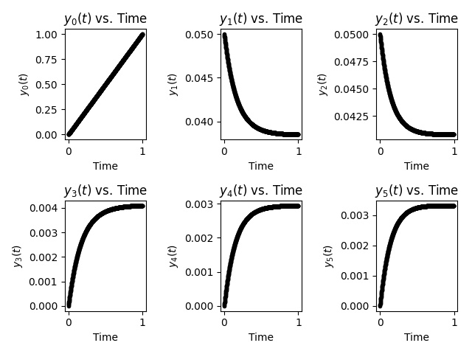
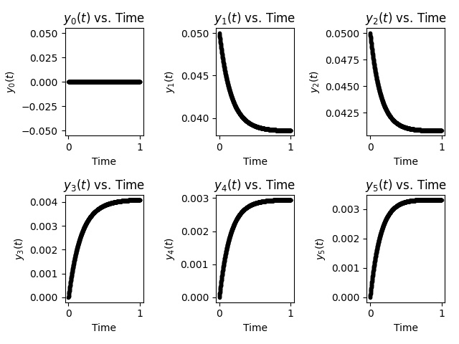
50-50 initial conditions for simulation GLYCINE TO ALANINE
Y1->G
Y2->A
Y3->GG
Y4->AA
Y5
->GA/AG
ORIGINAL MODEL
PYSINDY RECOVERED MODEL

Slide 6

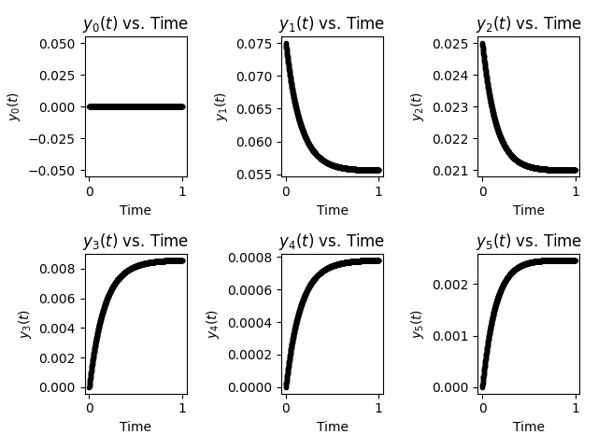
75-25 initial conditions for simulation GLYCINE TO ALANINE
Y1->G
Y2->A
Y3->GG
Y4->AA
Y5
->GA/AG
ORIGINAL MODEL
PYSINDY RECOVERED MODEL

Slide 7
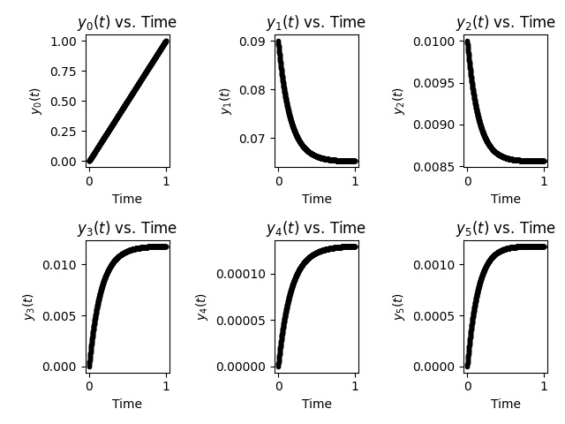
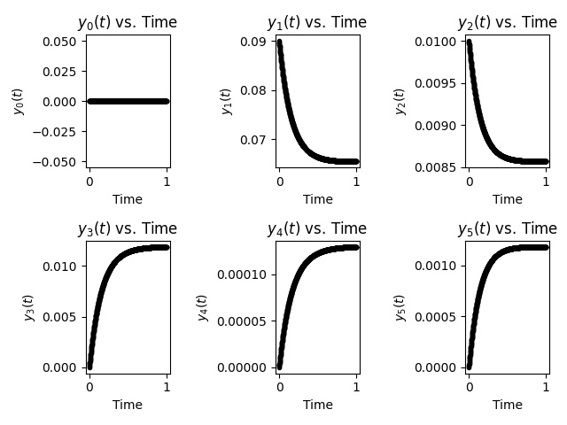
90-10 initial conditions for simulation GLYCINE TO ALANINE
Y1->G
Y2->A
Y3->GG
Y4->AA
Y5
->GA/AG
ORIGINAL MODEL
PYSINDY RECOVERED MODEL

Slide 8
FOR NEXT TIME
Work in noise addition as before.

